Slide 1
Cryptography and Network Security
SET for E-COMMERCE TRANSACTIONS

Slide 2
Session Meta Data
Author | Dr T Sree Sharmila
Reviewer
Version Number | 1.0
Release Date | 6 August 2018

Slide 3
Revision History
Revision Date | Details | Version no.
 |  | 1.0

Slide 4
Agenda
Credit cards
Secure Electronic Transactions (SET) System
SET requirement
SET Transaction
Key technologies of SET
Dual Signature
DS verification by merchant
DS verification by bank
SET supported transaction
Purchase request
Merchant verifies purchase request
Purchase response message
Payment processing
Summary
Test your understanding
References

Slide 5
Credit Cards on the Internet
Problem: communicate credit card and purchasing data securely to gain consumer trust
Authentication of buyer and merchant
Confidential transmissions
Systems vary by
Type of public-key encryption
Type of symmetric encryption
Message digest algorithm
Number of parties having private keys
Number of parties having certificates
Notes:
52

Slide 6
Credit Card Protocols
SSL 1 or 2 parties have private keys
TLS (Transport Layer Security)
IETF version of SSL
i KP (IBM)
SEPP (Secure Encryption Payment Protocol)
MasterCard, IBM, Netscape
STT (Secure Transaction Technology)
VISA, Microsoft
SET (Secure Electronic Transactions)
MasterCard, VISA all parties have certificates
OBSOLETE
VERY SLOW
ACCEPTANCE
Notes:
52

Slide 7
Agenda
Credit cards
Secure Electronic Transactions (SET) System
SET requirement
SET Transaction
Key technologies of SET
Dual Signature
DS verification by merchant
DS verification by bank
SET supported transaction
Purchase request
Merchant verifies purchase request
Purchase response message
Payment processing
Summary
Test your understanding
References

Slide 8
Secure Electronic Transaction (SET)
Developed by Visa and MasterCard
Designed to protect credit card transactions
Confidentiality: all messages encrypted
Trust: all parties must have digital certificates
Privacy: information made available only when and where necessary

Slide 9
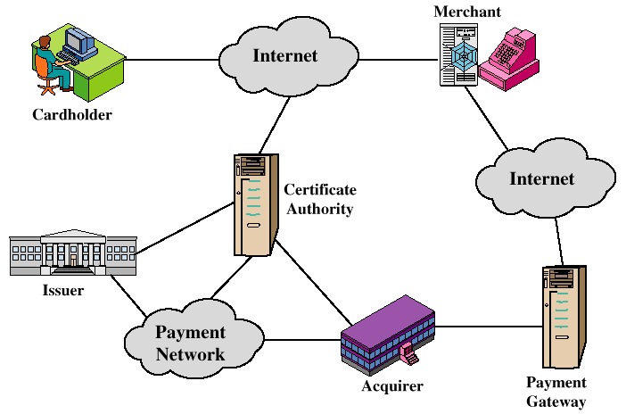
Participants in the SET System

Slide 10
Agenda
Credit cards
Secure Electronic Transactions (SET) System
SET requirement
SET Transaction
Key technologies of SET
Dual Signature
DS verification by merchant
DS verification by bank
SET supported transaction
Purchase request
Merchant verifies purchase request
Purchase response message
Payment processing
Summary
Test your understanding
References

Slide 11
SET Business Requirements
Provide confidentiality of payment and ordering information
Ensure the integrity of all transmitted data
Provide authentication that a cardholder is a legitimate user of a credit card account
Provide authentication that a merchant can accept credit card transactions through its relationship with a financial institution

Slide 12
SET Business Requirements (cont’d)
Ensure the use of the best security practices and system design techniques to protect all legitimate parties in an electronic commerce transaction
Create a protocol that neither depends on transport security mechanisms nor prevents their use
Facilitate and encourage interoperability among software and network providers

Slide 13
Agenda
Credit cards
Secure Electronic Transactions (SET) System
SET requirement
SET Transaction
Key technologies of SET
Dual Signature
DS verification by merchant
DS verification by bank
SET supported transaction
Purchase request
Merchant verifies purchase request
Purchase response message
Payment processing
Summary
Test your understanding
References

Slide 14
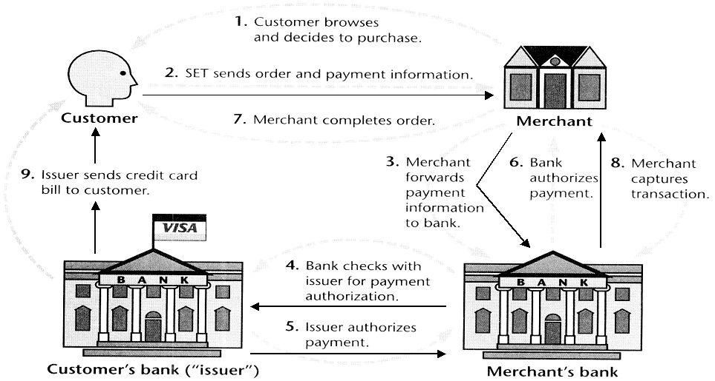
SET Transactions

Slide 15
SET Transactions
The customer opens an account with a card issuer.
MasterCard, Visa, etc.
The customer receives a X.509 V3 certificate signed by a bank.
X.509 V3
A merchant who accepts a certain brand of card must possess two X.509 V3 certificates.
One for signing & one for key exchange
The customer places an order for a product or service with a merchant.
The merchant sends a copy of its certificate for verification.
Notes:
SET Transaction:
Customer Opens An Account: Customer obtains a credit card account with a bank that supports electronic payment and SET.
Customer Receives A Certificate: After suitable verification of identity, the customer receives an X.509v3 digital certificate signed by the bank.
It verifies the customer’s RSA public key and its expiration date.
Merchants Have Own Certificates: A merchant who accepts a bank card must be in possession of two certificates for the two public keys owned by the merchant:
One for signing messages
One for key exchange
Merchant has a copy of payment gateway’s public-key certificate.
Customer Places An Order: Customer send a list of items to be purchases to the merchant, who returns an order form containing the list of items to be purchased to the merchant.
Merchant returns an order form containing the list of items, their price, a total price, and an order number.
Merchant is Verified: In addition to the order form, the merchant sends a copy of the certificate so that the customer can verify that he or she is dealing with a valid store.

Slide 16
SET Transactions
The customer sends order and payment information to the merchant.
The merchant requests payment authorization from the payment gateway prior to shipment.
The merchant confirms order to the customer.
The merchant provides the goods or service to the customer.
The merchant requests payment from the payment gateway.
Notes:
SET Transaction:
Order and Payment are Sent: Customer sends both order and payment information to merchant along with customer’s certificate.
The order confirms the purchase of items in the order form.
The payment contains credit card details.
The payment information is encrypted so that it cannot be read by the merchant.
The customer’s certificate enables the merchant to verify the customer.
Merchant Requests Payment Authorization: Merchant sends the payment information to the payment gateway.
This requests authorization that the customer’s available credit is sufficient for this purchase.
Merchant Confirms Order: Merchant sends a confirmation of the order to the customer.
Merchant Provides Goods or Service: Merchant ships the goods or provides the service to the customer.
Merchant Requests Payment: Request is sent to payment gateway to handle payment processing

Slide 17
Agenda
Credit cards
Secure Electronic Transactions (SET) System
SET requirement
SET Transaction
Key technologies of SET
Dual Signature
DS verification by merchant
DS verification by bank
SET supported transaction
Purchase request
Merchant verifies purchase request
Purchase response message
Payment processing
Summary
Test your understanding
References

Slide 18
Key Technologies of SET
Confidentiality of information: DES
Integrity of data: RSA digital signatures with SHA-1 hash codes
Cardholder account authentication: X.509v3 digital certificates with RSA signatures
Merchant authentication: X.509v3 digital certificates with RSA signatures
Privacy: separation of order and payment information using dual signatures

Slide 19
Agenda
Credit cards
Secure Electronic Transactions (SET) System
SET requirement
SET Transaction
Key technologies of SET
Dual Signature
DS verification by merchant
DS verification by bank
SET supported transaction
Purchase request
Merchant verifies purchase request
Purchase response message
Payment processing
Summary
Test your understanding
References

Slide 20
Dual Signatures
Links two messages securely but allows only one party to read each.
MESSAGE 1
MESSAGE 2
HASH 1 & 2
WITH SHA
CONCATENATE DIGESTS
TOGETHER
DIGEST 1
DIGEST 2
HASH WITH SHA TO
CREATE NEW DIGEST
NEW DIGEST
PRIVATE KEY
ENCRYPT NEW DIGEST
WITH SIGNER’S PRIVATE KEY
DUAL SIGNATURE

Slide 21
Dual Signature for SET
Concept: Link Two Messages Intended for Two Different Receivers:
Order Information (OI): Customer to Merchant
Payment Information (PI): Customer to Bank
Goal: Limit Information to A “Need-to-Know” Basis:
Merchant does not need credit card number.
Bank does not need details of customer order.
Afford the customer extra protection in terms of privacy by keeping these items separate.
This link is needed to prove that payment is intended for this order and not some other one.
Notes:
SET Transaction:
Order and Payment are Sent: Customer sends both order and payment information to merchant along with customer’s certificate.
The order confirms the purchase of items in the order form.
The payment contains credit card details.
The payment information is encrypted so that it cannot be read by the merchant.
The customer’s certificate enables the merchant to verify the customer.
Merchant Requests Payment Authorization: Merchant sends the payment information to the payment gateway.
This requests authorization that the customer’s available credit is sufficient for this purchase.
Merchant Confirms Order: Merchant sends a confirmation of the order to the customer.
Merchant Provides Goods or Service: Merchant ships the goods or provides the service to the customer.
Merchant Requests Payment: Request is sent to payment gateway to handle payment processing

Slide 22
Why Dual Signature?
Suppose that customers send the merchant two messages:
The signed order information (OI).
The signed payment information (PI).
In addition, the merchant passes the payment information (PI) to the bank.
If the merchant can capture another order information (OI) from this customer, the merchant could claim this order goes with the payment information (PI) rather than the original.
Notes:
SET Transaction:
Order and Payment are Sent: Customer sends both order and payment information to merchant along with customer’s certificate.
The order confirms the purchase of items in the order form.
The payment contains credit card details.
The payment information is encrypted so that it cannot be read by the merchant.
The customer’s certificate enables the merchant to verify the customer.
Merchant Requests Payment Authorization: Merchant sends the payment information to the payment gateway.
This requests authorization that the customer’s available credit is sufficient for this purchase.
Merchant Confirms Order: Merchant sends a confirmation of the order to the customer.
Merchant Provides Goods or Service: Merchant ships the goods or provides the service to the customer.
Merchant Requests Payment: Request is sent to payment gateway to handle payment processing

Slide 23
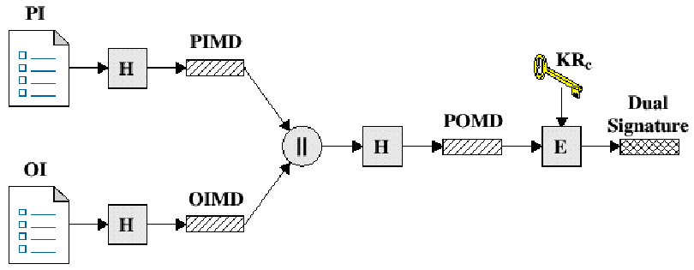
Dual Signature Operation
The operation for dual signature is as follows:
Take the hash (SHA-1) of the payment and order information.
These two hash values are concatenated [H(PI) || H(OI)] and then the result is hashed.
Customer encrypts the final hash with a private key creating the dual signature.
DS = E_{KRC} [ H(H(PI) || H(OI)) ]
Notes:
SET Transaction:
Order and Payment are Sent: Customer sends both order and payment information to merchant along with customer’s certificate.
The order confirms the purchase of items in the order form.
The payment contains credit card details.
The payment information is encrypted so that it cannot be read by the merchant.
The customer’s certificate enables the merchant to verify the customer.
Merchant Requests Payment Authorization: Merchant sends the payment information to the payment gateway.
This requests authorization that the customer’s available credit is sufficient for this purchase.
Merchant Confirms Order: Merchant sends a confirmation of the order to the customer.
Merchant Provides Goods or Service: Merchant ships the goods or provides the service to the customer.
Merchant Requests Payment: Request is sent to payment gateway to handle payment processing

Slide 24
Agenda
Credit cards
Secure Electronic Transactions (SET) System
SET requirement
SET Transaction
Key technologies of SET
Dual Signature
DS verification by merchant
DS verification by bank
SET supported transaction
Purchase request
Merchant verifies purchase request
Purchase response message
Payment processing
Summary
Test your understanding
References

Slide 25
DS Verification by Merchant
The merchant has the public key of the customer obtained from the customer’s certificate.
Now, the merchant can compute two values:
H(PIMD || H(OI))
D_{KUC}[DS]
Should be equal!
Notes:
SET Transaction:
Order and Payment are Sent: Customer sends both order and payment information to merchant along with customer’s certificate.
The order confirms the purchase of items in the order form.
The payment contains credit card details.
The payment information is encrypted so that it cannot be read by the merchant.
The customer’s certificate enables the merchant to verify the customer.
Merchant Requests Payment Authorization: Merchant sends the payment information to the payment gateway.
This requests authorization that the customer’s available credit is sufficient for this purchase.
Merchant Confirms Order: Merchant sends a confirmation of the order to the customer.
Merchant Provides Goods or Service: Merchant ships the goods or provides the service to the customer.
Merchant Requests Payment: Request is sent to payment gateway to handle payment processing

Slide 26
Agenda
Credit cards
Secure Electronic Transactions (SET) System
SET requirement
SET Transaction
Key technologies of SET
Dual Signature
DS verification by merchant
DS verification by bank
SET supported transaction
Purchase request
Merchant verifies purchase request
Purchase response message
Payment processing
Summary
Test your understanding
References

Slide 27
DS Verification by Bank
The bank is in possession of DS, PI, the message digest for OI (OIMD), and the customer’s public key, then the bank can compute the following:
H(H(PI) || OIMD)
D_{KUC} [ DS ]
Notes:
SET Transaction:
Order and Payment are Sent: Customer sends both order and payment information to merchant along with customer’s certificate.
The order confirms the purchase of items in the order form.
The payment contains credit card details.
The payment information is encrypted so that it cannot be read by the merchant.
The customer’s certificate enables the merchant to verify the customer.
Merchant Requests Payment Authorization: Merchant sends the payment information to the payment gateway.
This requests authorization that the customer’s available credit is sufficient for this purchase.
Merchant Confirms Order: Merchant sends a confirmation of the order to the customer.
Merchant Provides Goods or Service: Merchant ships the goods or provides the service to the customer.
Merchant Requests Payment: Request is sent to payment gateway to handle payment processing

Slide 28
What did we accomplish?
The merchant has received OI and verified the signature.
The bank has received PI and verified the signature.
The customer has linked the OI and PI and can prove the linkage.
Notes:
SET Transaction:
Order and Payment are Sent: Customer sends both order and payment information to merchant along with customer’s certificate.
The order confirms the purchase of items in the order form.
The payment contains credit card details.
The payment information is encrypted so that it cannot be read by the merchant.
The customer’s certificate enables the merchant to verify the customer.
Merchant Requests Payment Authorization: Merchant sends the payment information to the payment gateway.
This requests authorization that the customer’s available credit is sufficient for this purchase.
Merchant Confirms Order: Merchant sends a confirmation of the order to the customer.
Merchant Provides Goods or Service: Merchant ships the goods or provides the service to the customer.
Merchant Requests Payment: Request is sent to payment gateway to handle payment processing

Slide 29
Agenda
Credit cards
Secure Electronic Transactions (SET) System
SET requirement
SET Transaction
Key technologies of SET
Dual Signature
DS verification by merchant
DS verification by bank
SET supported transaction
Purchase request
Merchant verifies purchase request
Purchase response message
Payment processing
Summary
Test your understanding
References

Slide 30
SET Supported Transactions
card holder registration
merchant registration
purchase request
payment authorization
payment capture
certificate query
purchase inquiry
purchase notification
sale transaction
authorization reversal
capture reversal
credit reversal
Notes:
52

Slide 31
Agenda
Credit cards
Secure Electronic Transactions (SET) System
SET requirement
SET Transaction
Key technologies of SET
Dual Signature
DS verification by merchant
DS verification by bank
SET supported transaction
Purchase request
Merchant verifies purchase request
Purchase response message
Payment processing
Summary
Test your understanding
References

Slide 32
Purchase Request
Browsing, Selecting, and Ordering is Done
Purchasing Involves 4 Messages:
Initiate Request
Initiate Response
Purchase Request
Purchase Response

Slide 33
Purchase Request: Initiate Request
Basic Requirements:
Cardholder Must Have Copy of Certificates for Merchant and Payment Gateway
Customer Requests the Certificates in the Initiate Request Message to Merchant
Brand of Credit Card
ID Assigned to this Request/response pair by customer
Nonce

Slide 34
Purchase Request: Initiate Response
Merchant Generates a Response
Signs with Private Signature Key
Include Customer Nonce
Include Merchant Nonce (Returned in Next Message)
Transaction ID for Purchase Transaction
In Addition …
Merchant’s Signature Certificate
Payment Gateway’s Key Exchange Certificate

Slide 35
Purchase Request: Purchase Request
Cardholder Verifies Two Certificates Using Their CAs and Creates the OI and PI.
Message Includes:
Purchase-related Information
Order-related Information
Cardholder Certificate

Slide 36
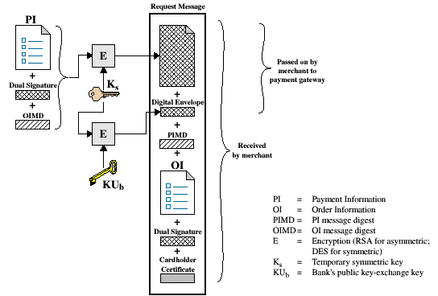
Purchase Request
The cardholder generates a one-time symmetric encryption key, KS,
Notes:
Cardholder Sends Purchase Request Message:
Message Includes:
Purchase-related Information: Forwarded to the Payment Gateway by the Merchant
PI
Dual Signature calculated over PI and OI and signed with the customer’s private signature key
OI Message Digest (OIMD)
Digital Envelope
Order-related Information: Information needed by Merchant
OI
Dual Signature
PI Message Digest (PIMD)
Cardholder Certificate: Contains the Cardholder’s public signature key
Used by Merchant and by Payment Gateway

Slide 37
Agenda
Credit cards
Secure Electronic Transactions (SET) System
SET requirement
SET Transaction
Key technologies of SET
Dual Signature
DS verification by merchant
DS verification by bank
SET supported transaction
Purchase request
Merchant verifies purchase request
Purchase response message
Payment processing
Summary
Test your understanding
References

Slide 38
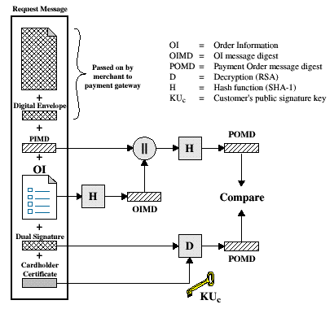
Merchant Verifies Purchase Request
When the merchant receives the Purchase Request message, it performs the following actions:
Verify the cardholder certificates by means of its CA signatures.
Verifies the dual signature using the customer’s public key signature.
Notes:
Merchant Handles Purchase Request Message:
When Merchant receives the Purchase Request Message:
Verifies the Cardholder Certificate using its CA Signatures
Verifies the Dual Signature using the customer’s public signature key.
This ensures that the order has not been tampered with in transit and that it was signed using the cardholder’s private key.
Process the order and forward the payment information to the payment gateway for authorization.
Send a purchase response to cardholder.

Slide 39
Merchant Verification (cont’d)
Processes the order and forwards the payment information to the payment gateway for authorization.
Sends a purchase response to the cardholder.
Notes:
Merchant Handles Purchase Request Message:
When Merchant receives the Purchase Request Message:
Verifies the Cardholder Certificate using its CA Signatures
Verifies the Dual Signature using the customer’s public signature key.
This ensures that the order has not been tampered with in transit and that it was signed using the cardholder’s private key.
Process the order and forward the payment information to the payment gateway for authorization.
Send a purchase response to cardholder.

Slide 40
Agenda
Credit cards
Secure Electronic Transactions (SET) System
SET requirement
SET Transaction
Key technologies of SET
Dual Signature
DS verification by merchant
DS verification by bank
SET supported transaction
Purchase request
Merchant verifies purchase request
Purchase response message
Payment processing
Summary
Test your understanding
References

Slide 41
Purchase Response Message
Message that Acknowledges the Order and References Corresponding Transaction Number
Block is
Signed by Merchant Using its Private Key
Block and Signature Are Sent to Customer Along with Merchant’s Signature Certificate
Upon Reception
Verifies Merchant Certificate
Verifies Signature on Response Block
Takes the Appropriate Action

Slide 42
Agenda
Credit cards
Secure Electronic Transactions (SET) System
SET requirement
SET Transaction
Key technologies of SET
Dual Signature
DS verification by merchant
DS verification by bank
SET supported transaction
Purchase request
Merchant verifies purchase request
Purchase response message
Payment processing
Summary
Test your understanding
References

Slide 43
Payment Process
The payment process is broken down into two steps:
Payment authorization
Payment capture
Notes:
Authorization Request Message:
Purchase-related Information: Customer Information
PI
Dual Signature
OI Message Digest (OIMD)
Digital Envelope
Authorization-related Information: Merchant Information
Authorization Block:
Transaction ID
Signed with Merchant’s Private Key
Encrypted with One-time Key Generated by Merchant
Digital Envelope: Encrypt One-time Key with Private Key
Certificates:
Cardholder’s Signature Key Certificate (Verify Dual Sign.)
Merchant’s Signature Key Certificate (Verify Merchant)
Merchant’s Key-exchange Certificate (Gateway I/F)

Slide 44
Payment Authorization
The merchant sends an authorization request message to the payment gateway consisting of the following:
Purchase-related information
PI
Dual signature calculated over the PI & OI and signed with customer’s private key.
The OI message digest (OIMD)
The digital envelop
Authorization-related information
Certificates
Notes:
Authorization Request Message:
Purchase-related Information: Customer Information
PI
Dual Signature
OI Message Digest (OIMD)
Digital Envelope
Authorization-related Information: Merchant Information
Authorization Block:
Transaction ID
Signed with Merchant’s Private Key
Encrypted with One-time Key Generated by Merchant
Digital Envelope: Encrypt One-time Key with Private Key
Certificates:
Cardholder’s Signature Key Certificate (Verify Dual Sign.)
Merchant’s Signature Key Certificate (Verify Merchant)
Merchant’s Key-exchange Certificate (Gateway I/F)

Slide 45
Payment Authorization (cont’d)
Authorization-related information
An authorization block including:
A transaction ID
Signed with merchant’s private key
Encrypted one-time session key
Certificates
Cardholder’s signature key certificate
Merchant’s signature key certificate
Merchant’s key exchange certificate
Notes:
Authorization Request Message:
Purchase-related Information: Customer Information
PI
Dual Signature
OI Message Digest (OIMD)
Digital Envelope
Authorization-related Information: Merchant Information
Authorization Block:
Transaction ID
Signed with Merchant’s Private Key
Encrypted with One-time Key Generated by Merchant
Digital Envelope: Encrypt One-time Key with Private Key
Certificates:
Cardholder’s Signature Key Certificate (Verify Dual Sign.)
Merchant’s Signature Key Certificate (Verify Merchant)
Merchant’s Key-exchange Certificate (Gateway I/F)

Slide 46
Payment: Payment Gateway
Verify All Certificates
Decrypt Authorization Block Digital Envelope to Obtain Symmetric Key and Decrypt Block
Verify Merchant Signature on Authorization Block
Decrypt Payment Block Digital Envelope to Obtain Symmetric Key and Decrypt Block
Verify Dual Signature on Payment Block
Verify Received Transaction ID Received from Merchant Matches PI Received from Customer
Request and Receive Issuer Authorization

Slide 47
Authorization Response
Authorization Response Message
Authorization-related Information
Capture Token Information
Certificate
Notes:
Authorization Response Message:
Authorization-related Information: Authorization blocks
Signed by Gateway’s private key
Encrypted with one-time symmetric key generated by Gateway
Digital envelope containing one-time key encrypted with Merchant’s public key
Capture Token Information: Information to be used to effect payment.
Block
Signed, encrypted Capture Token with Digital Envelope
Not processed by merchant
Must be returned with a payment request
Certificate: The Gateway’s signature key certificate.

Slide 48
Agenda
Credit cards
Secure Electronic Transactions (SET) System
SET requirement
SET Transaction
Key technologies of SET
Dual Signature
DS verification by merchant
DS verification by bank
SET supported transaction
Purchase request
Merchant verifies purchase request
Purchase response message
Payment processing
Summary
Test your understanding
References

Slide 49
Summary
Simple purchase transaction:
Four messages between merchant and customer
Two messages between merchant and payment gateway
6 digital signatures
9 RSA encryption/decryption cycles
4 DES encryption/decryption cycles
4 certificate verifications
Scaling:
Multiple servers need copies of all certificates
Notes:
52

Slide 50
Agenda
Credit cards
Secure Electronic Transactions (SET) System
SET requirement
SET Transaction
Key technologies of SET
Dual Signature
DS verification by merchant
DS verification by bank
SET supported transaction
Purchase request
Merchant verifies purchase request
Purchase response message
Payment processing
Summary
Test your understanding
References

Slide 51
Test your understanding
Explain SET in detail.

Slide 52
Agenda
Credit cards
Secure Electronic Transactions (SET) System
SET requirement
SET Transaction
Key technologies of SET
Dual Signature
DS verification by merchant
DS verification by bank
SET supported transaction
Purchase request
Merchant verifies purchase request
Purchase response message
Payment processing
Summary
Test your understanding
References

Slide 53
References
1. William Stallings, Cryptography and Network Security, 6th Edition, Pearson Education, March 2013.
2. Charlie Kaufman, Radia Perlman and Mike Speciner, “Network Security”, Prentice Hall of India, 2002.

